Slide 1
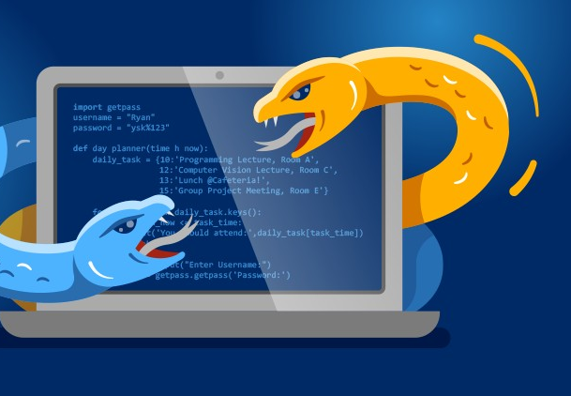

Python Fundamentals
By Ch€f

Slide 2
Python Bootcamp
Course Overview Lecture
Useful tips for going through the course
How to get help during the course
Advice on how to approach the course
Where to find the course notebooks
How to use the student chat channel

Slide 3
Useful Tips
Watch recordings if you think that you missed something.
Download the course code from files tab and test it yourself.
Make sure you are asking questions when you don’t understand something.

Slide 4
How to get help
Double check against course notebooks
Quick Google or StackOverflow Search
Contact the instructor via email of chat
Check out questions channel
Submit new question in QA forums
Details on what you’ve tried
Screenshot of error or code

Slide 5

How to get help
Please contact chef:
From: Yilmaz.Mustafa@intecbrussel.be
Course materials
Questions about lessons
Code, assignments, exams
Please do NOT contact :
Administrative requests
Exceptional requests for attendance.
Hacking Pentagon!

Slide 6

How to approach course
Best way to approach the course is review the notebooks along with the video
Beginners: Read extra notes in the notebook along with the video guide.
Experienced: Read the notebooks to see if you only need to review certain parts of the video lecture.

Slide 7


Course Notebooks
Check your Automated Welcome message for the link to the notebooks.
Later, we will review how to download and open them Running Python Code lecture.
Link is also in the FAQ lecture.

Slide 8

Student Chat Channel
Use the link to view our Teams chat channel.
The MS Teams channel messages also includes a link to a session recordings.
Remember, purpose of chat channel is to connect students with other students as well as instructors.
Technical questions related to course material are best suited for the QA forums.

Slide 9

Python 2 VS Python 3

Slide 10

Python Bootcamp
Choosing between Python 2 vs 3 used to be a very difficult decision for newcomers to the Python programming language.
Many companies still had legacy Python 2 code to be maintained.
This course was initially released teaching both versions of Python (2 and 3).
The versions were similar enough that it was easy to learn both simultaneously.
Now every major external python package has been updated to support Python 3!

Slide 11
Python Bootcamp
This course now focuses solely on Python 3.
All the code, notebooks, and videos have been updated to Python 3.
If need be, going back to Python 2 syntax is a very easy jump once you know Python 3.

Slide 12
Python Bootcamp
Python 3 is the future of Python.
We use Python 3 for this course.
Old notebooks are available in case you need Python 2 information.
Let’s get started by installing Python 3!

Slide 13
Command Line
Crash Course

Slide 14
Complete Python Bootcamp
Before we install anything, its important to have a very quick overview of how to work at the command line.
This allows you to programmatically move through your computer’s directories.

Slide 15
Complete Python Bootcamp
We will cover:
Find your current directory
Listing all files in a directory
How to change directory
How to clear the command line screen
How to create a text file and read it

Slide 16
Complete Python Bootcamp
MacOS and Linux Users
Jump to:
Windows Users
Jump to:

Slide 17
Python Overview

Slide 18
Complete Python Bootcamp
In this lecture we will do a brief overview of what Python is, why choose Python for programming, and what you can do with Python.
This lecture is geared towards people new to programming.

Slide 19
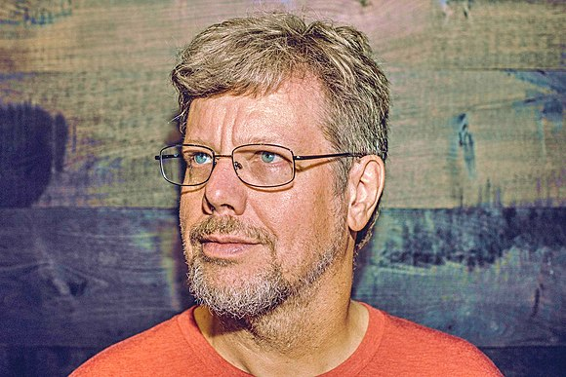
Python Bootcamp
Brief History of Python
Created in 1990 by Guido van Rossum
Python 3 released in 2008

Slide 20
Python Bootcamp
Brief History of Python
Specifically designed as an easy-to-use language
High focus on readability of code

Slide 21
Python Bootcamp
Why Choose Python?
Designed for clear, logical code that is easy to read and learn.
Lots of existing libraries and frameworks written in Python allowing users to apply Python to a wide variety of tasks.

Slide 22
Complete Python Bootcamp
Why Choose Python?
Focuses on optimizing developer time, rather than a computer’s processing time.
Great documentation online:
docs.python.org/3

Slide 23
Complete Python Bootcamp
What can you do with Python?
This course first focuses on “base” Python, which consists of the core components of the language and writing scripts and small programs.
Later we begin to learn about outside libraries and frameworks that greatly expand Python’s capabilities.

Slide 24
Complete Python Bootcamp
What can you do with Python?
Automate simple tasks
Searching for files and editing them
Scraping information from a website
Reading and editing excel files
Work with PDFs
Automate emails and text messages
Fill out forms

Slide 25
Complete Python Bootcamp
What can you do with Python?
Data Science and Machine Learning
Analyze large data files
Create visualizations
Perform machine learning tasks
Create and run predictive algorithms

Slide 26
Complete Python Bootcamp
What can you do with Python?
Create websites
Use web frameworks such as Django and Flask to handle the backend of a website and user data
Create interactive dashboards for users

Slide 27
Python Bootcamp
Once you understand base Python and begin working with a few libraries, you’ll quickly begin to see the vast potential Python has for your own projects!
Let’s get started with setting you up for the course!

Slide 28
Windows
Command Line

Slide 29

MacOS and Linux
Command Line

Slide 30
Python Overview
and
Installing Python

Slide 31
Complete Python Bootcamp
Developed by Guido Van Rossum in 1991 it has quickly become one of the most popular programming languages in the world.

Slide 32
Complete Python Bootcamp
Python has many advantages
Developers can learn it quickly
Typically involves less code
Syntax is easier to read
Utilized by every major technology company
Huge amount of additional open-source libraries.

Slide 33
Complete Python Bootcamp
To install Python we will use the free Anaconda distribution.
This distribution includes Python as well as many other useful libraries, including Jupyter.
Anaconda can also easily be installed on to any major OS, Windows, MacOS, or Linux.

Slide 34
Complete Python Bootcamp
There is also Miniconda , which is a smaller sized version of Anaconda.
To begin installation go to:
www.anaconda.com/downloads

Slide 35
Running Python Code

Slide 36
Complete Python Bootcamp
There are several ways to run Python code.
First let’s discuss the various options for development environments
There are 3 main types of environments:
Text Editors
Full IDEs
Notebook Environments

Slide 37
Complete Python Bootcamp
Text Editors
General editors for any text file
Work with a variety of file types
Can be customized with plugins and add-ons
Keep in mind, most are not designed with only Python in mind.
Most popular: Sublime Text and Atom

Slide 38
Complete Python Bootcamp
Full IDEs
Development Environments designed specifically for Python.
Larger programs.
Only community editions are free.
Designed specifically for Python, lots of extra functionality.
Most popular: PyCharm and Spyder

Slide 39
Complete Python Bootcamp
Notebook Environments
Great for learning.
See input and output next to each other.
Support in-line markdown notes, visualizations, videos, and more.
Special file formats that are not .py
Most popular is Jupyter Notebook.

Slide 40
Complete Python Bootcamp
Most important note:
Development Environments are a personal choice highly dependent on personal preference.
Choose whichever development environment you prefer!

Slide 41
Complete Python Bootcamp
Let’s now explore how to run Python code:
First with an editor to create a .py script and run the file at your command line.
Then with a Jupyter Notebook.
First let’s download sublime text editor:
www.sublimetext.com

Slide 42
Course Notebooks

Slide 43
Complete Python Bootcamp
Let’s show you how to get the course notebooks!
Go to the resource link:
https://github.com/Pierian-Data/Complete-Python-3-Bootcamp

